Slide 1
ATAI
Advanced Technique of Artificial Intelligence
ATAI
ChongqingUniversity _{AdvancedTechniqueof}
of Technology Artificial Intelligence
Chongqing University of
Technology
Chongqing University ^{ATAI}
_{of Technology} Advanced Techniqueof
Artificial Intelligence
Chongqing University of Technology
Chongqing University of Technology
Wavelet-based Fourier Information Interaction with Frequency Diffusion Adjustment for Underwater Image Restoration
Code : https://github.com/zhihefang/WF-Diff.
—— CVPR’2024
Reported by Yang Jiang
1

Slide 2
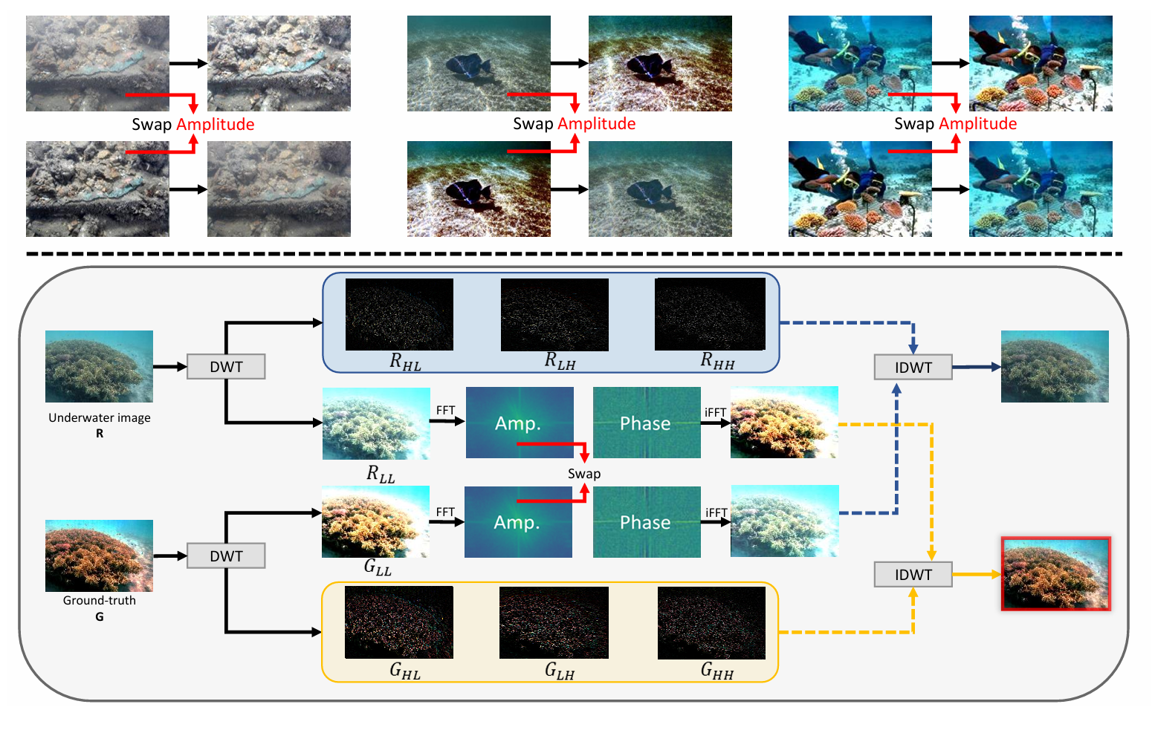
ATAI
Advanced Technique of Artificial Intelligence
ATAI
ChongqingUniversity _{AdvancedTechniqueof}
of Technology Artificial Intelligence
Chongqing University of
Technology
Chongqing University ^{ATAI}
_{of Technology} Advanced Techniqueof
Artificial Intelligence
Chongqing University of Technology
Chongqing University of Technology
Introduction

Slide 3
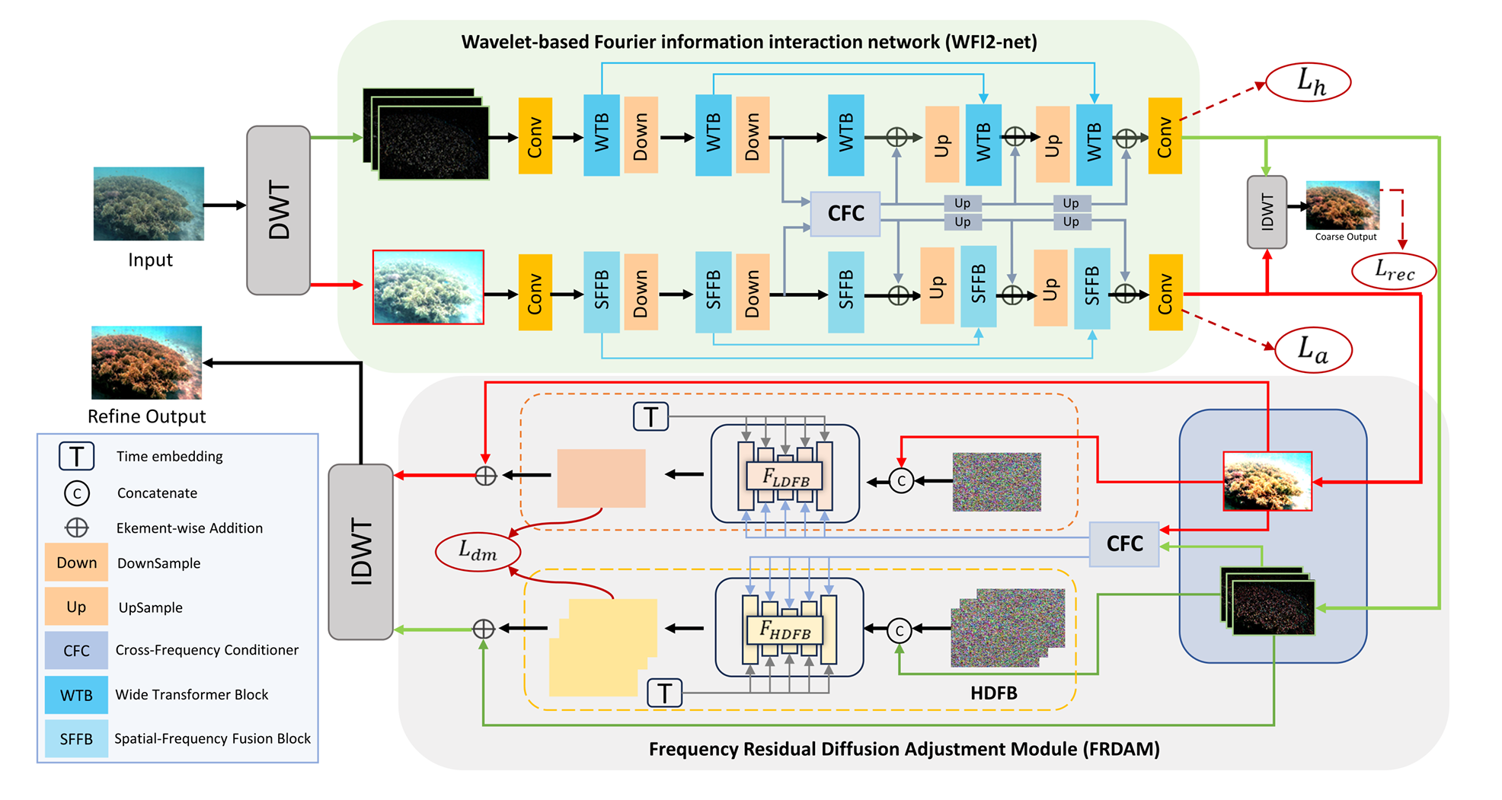
ATAI
Advanced Technique of Artificial Intelligence
ATAI
ChongqingUniversity _{AdvancedTechniqueof}
of Technology Artificial Intelligence
Chongqing University of
Technology
Chongqing University ^{ATAI}
_{of Technology} Advanced Techniqueof
Artificial Intelligence
Chongqing University of Technology
Chongqing University of Technology
Overview

Slide 4
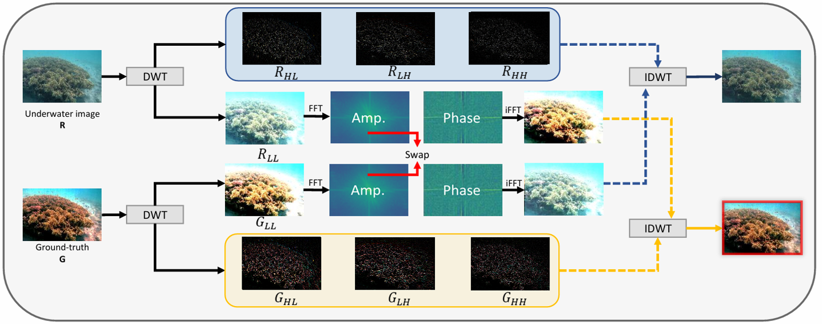
ATAI
Advanced Technique of Artificial Intelligence
ATAI
ChongqingUniversity _{AdvancedTechniqueof}
of Technology Artificial Intelligence
Chongqing University of
Technology
Chongqing University ^{ATAI}
_{of Technology} Advanced Techniqueof
Artificial Intelligence
Chongqing University of Technology
Chongqing University of Technology
Priliminary

Slide 5
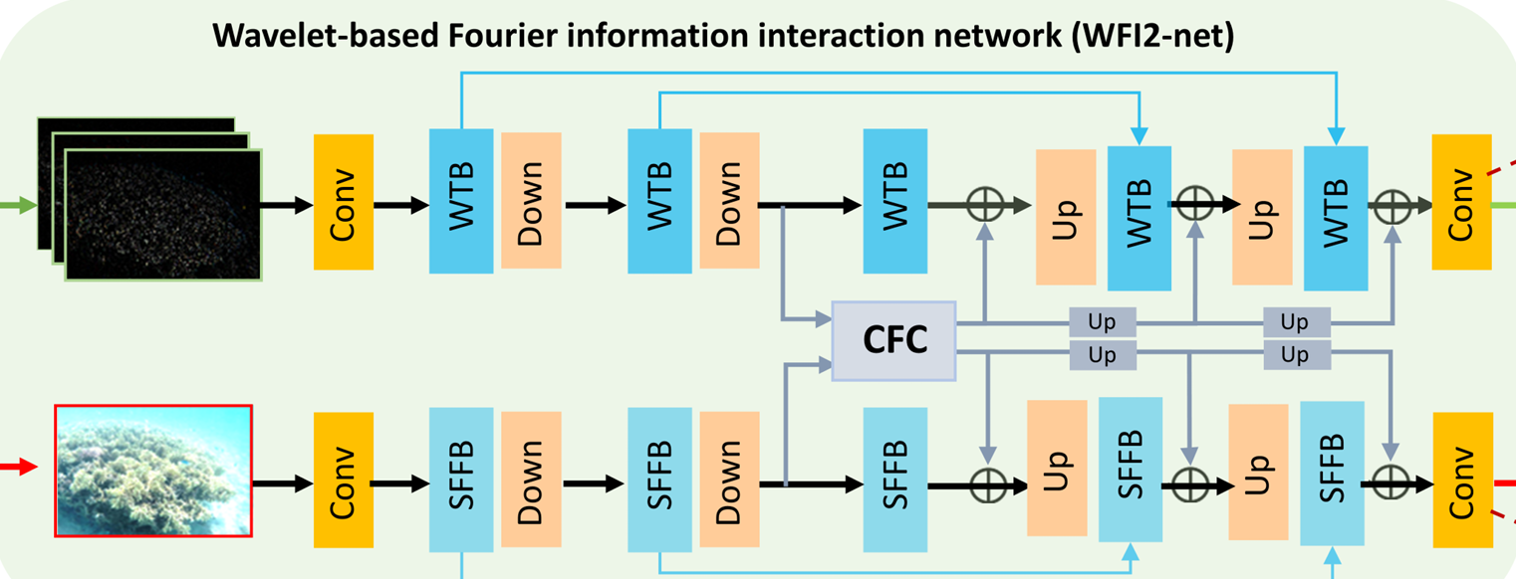
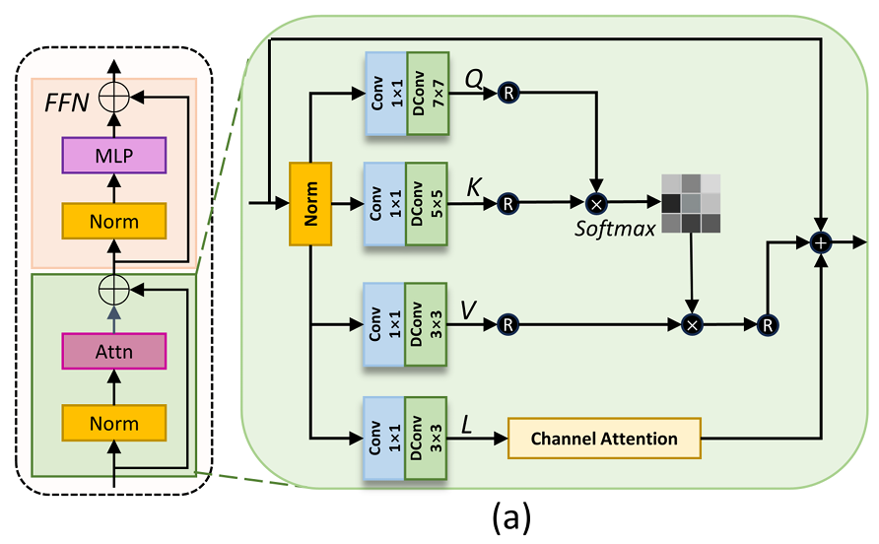
ATAI
Advanced Technique of Artificial Intelligence
ATAI
ChongqingUniversity _{AdvancedTechniqueof}
of Technology Artificial Intelligence
Chongqing University of
Technology
Chongqing University ^{ATAI}
_{of Technology} Advanced Techniqueof
Artificial Intelligence
Chongqing University of Technology
Chongqing University of Technology
Method

Slide 6
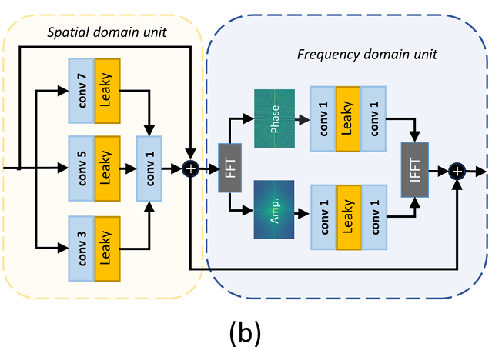
ATAI
Advanced Technique of Artificial Intelligence
ATAI
ChongqingUniversity _{AdvancedTechniqueof}
of Technology Artificial Intelligence
Chongqing University of
Technology
Chongqing University ^{ATAI}
_{of Technology} Advanced Techniqueof
Artificial Intelligence
Chongqing University of Technology
Chongqing University of Technology
Method

Slide 7
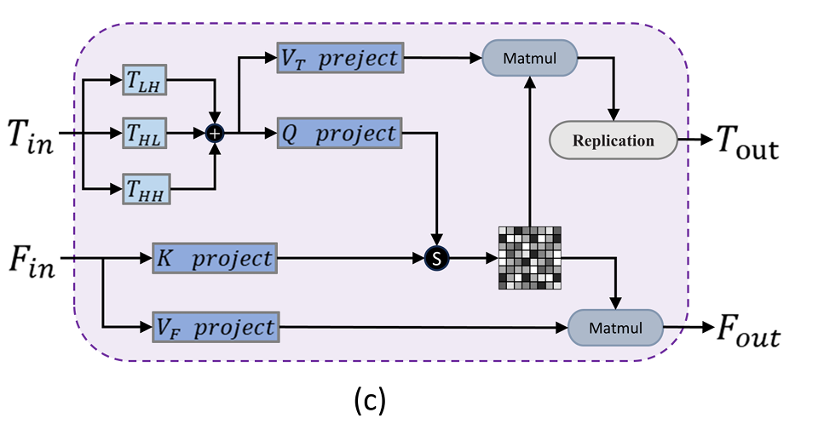
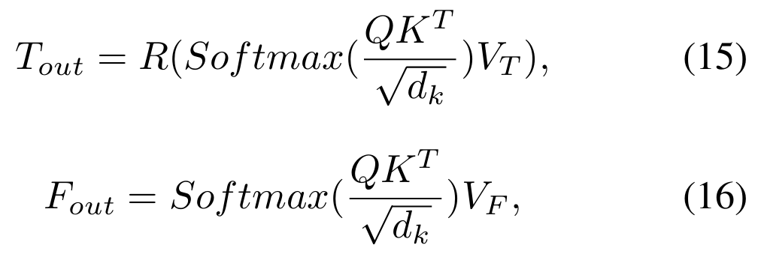
ATAI
Advanced Technique of Artificial Intelligence
ATAI
ChongqingUniversity _{AdvancedTechniqueof}
of Technology Artificial Intelligence
Chongqing University of
Technology
Chongqing University ^{ATAI}
_{of Technology} Advanced Techniqueof
Artificial Intelligence
Chongqing University of Technology
Chongqing University of Technology
Method

Slide 8
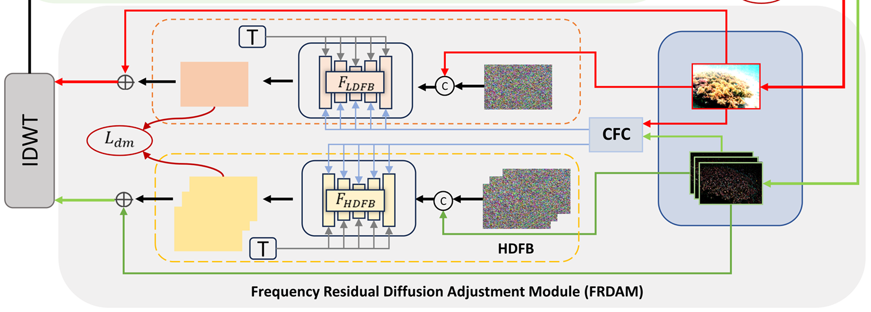
ATAI
Advanced Technique of Artificial Intelligence
ATAI
ChongqingUniversity _{AdvancedTechniqueof}
of Technology Artificial Intelligence
Chongqing University of
Technology
Chongqing University ^{ATAI}
_{of Technology} Advanced Techniqueof
Artificial Intelligence
Chongqing University of Technology
Chongqing University of Technology
Method

Slide 9
ATAI
Advanced Technique of Artificial Intelligence
ATAI
ChongqingUniversity _{AdvancedTechniqueof}
of Technology Artificial Intelligence
Chongqing University of
Technology
Chongqing University ^{ATAI}
_{of Technology} Advanced Techniqueof
Artificial Intelligence
Chongqing University of Technology
Chongqing University of Technology
Method

Slide 10
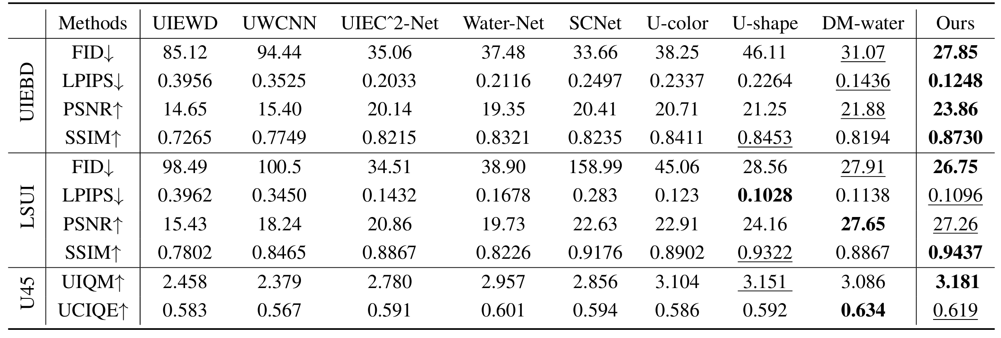
ATAI
Advanced Technique of Artificial Intelligence
ATAI
ChongqingUniversity _{AdvancedTechniqueof}
of Technology Artificial Intelligence
Chongqing University of
Technology
Chongqing University ^{ATAI}
_{of Technology} Advanced Techniqueof
Artificial Intelligence
Chongqing University of Technology
Chongqing University of Technology
Experiments

Slide 11
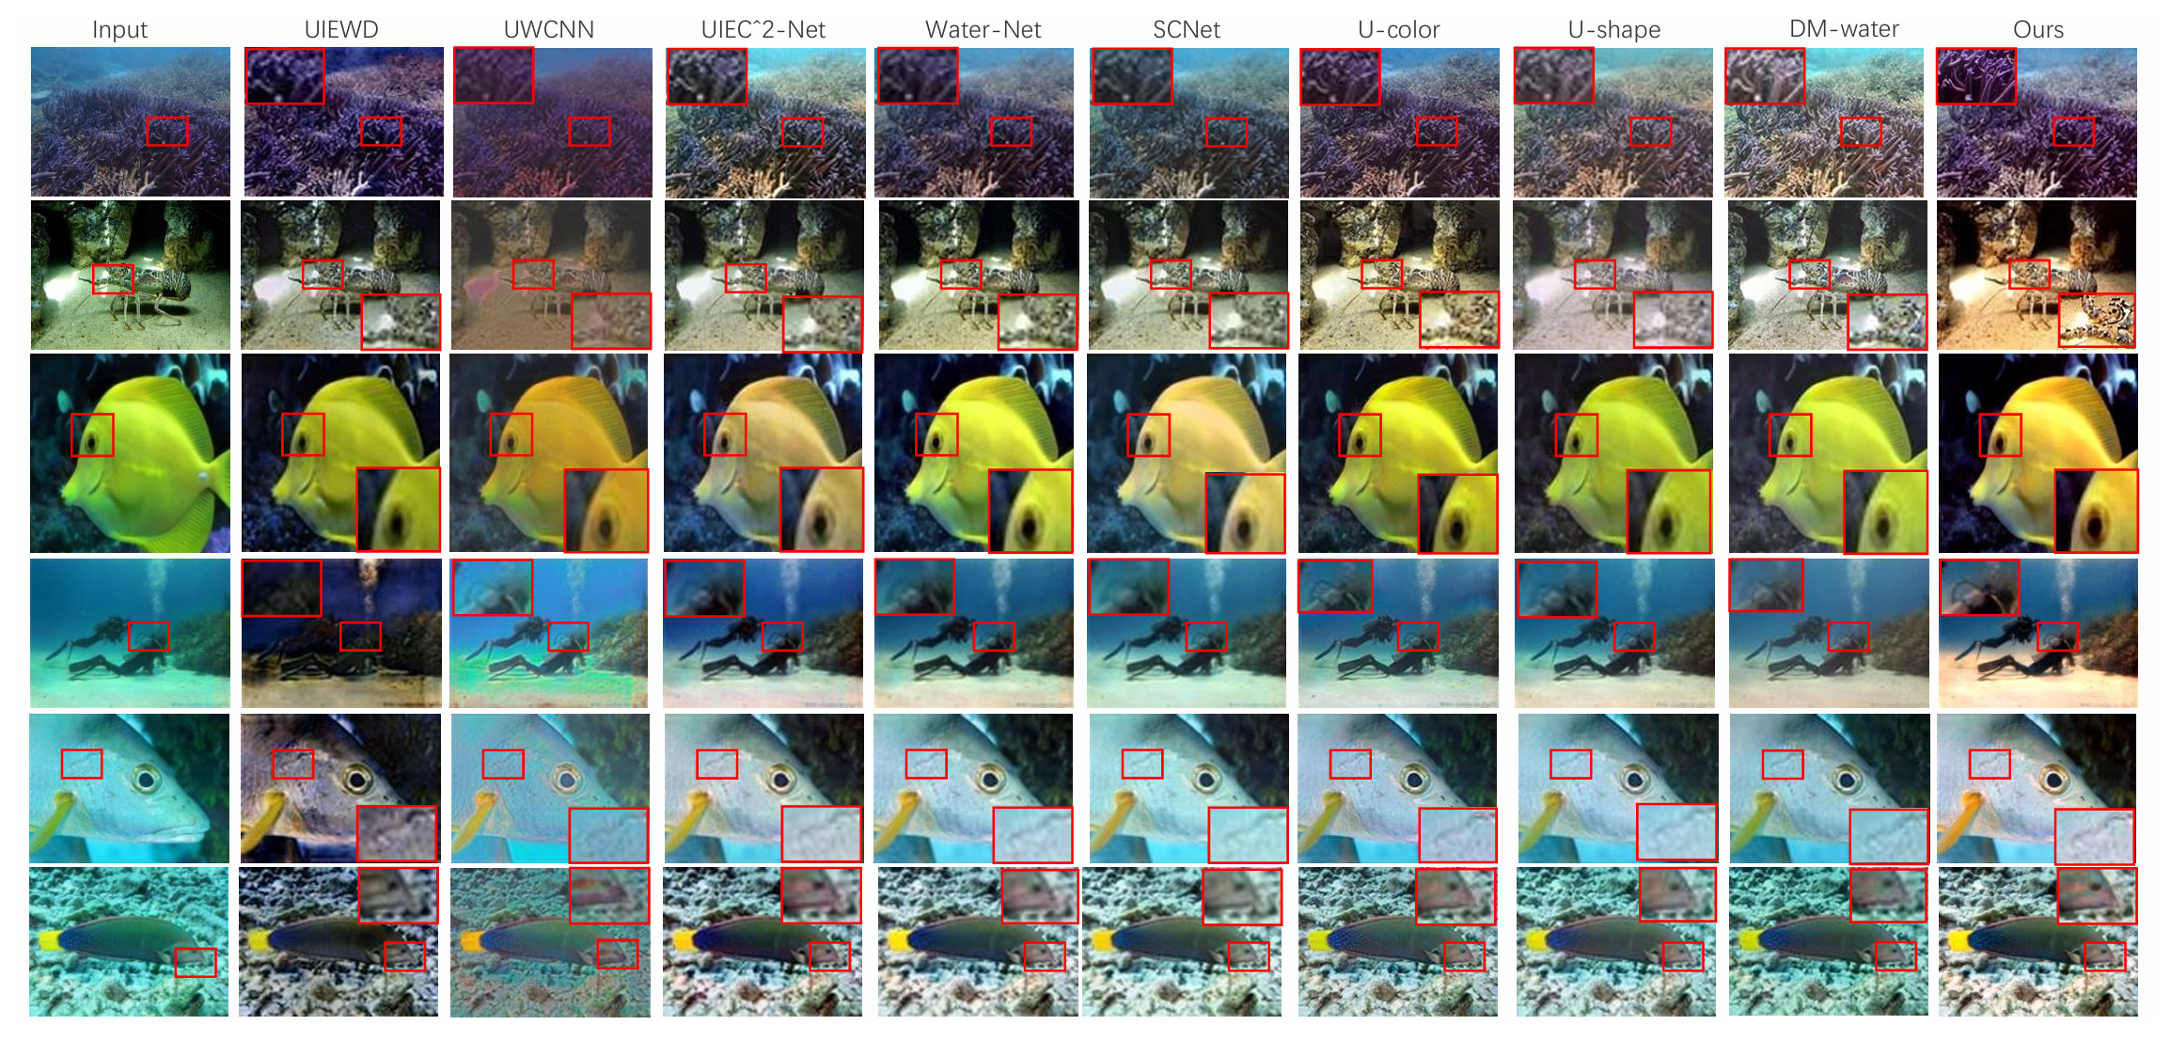
ATAI
Advanced Technique of Artificial Intelligence
ATAI
ChongqingUniversity _{AdvancedTechniqueof}
of Technology Artificial Intelligence
Chongqing University of
Technology
Chongqing University ^{ATAI}
_{of Technology} Advanced Techniqueof
Artificial Intelligence
Chongqing University of Technology
Chongqing University of Technology
Experiments

Slide 12
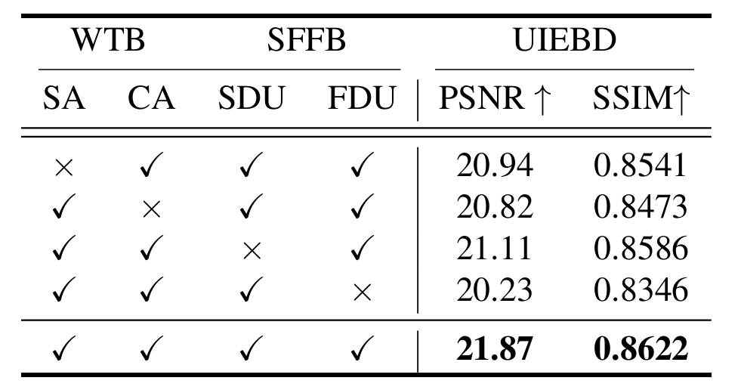
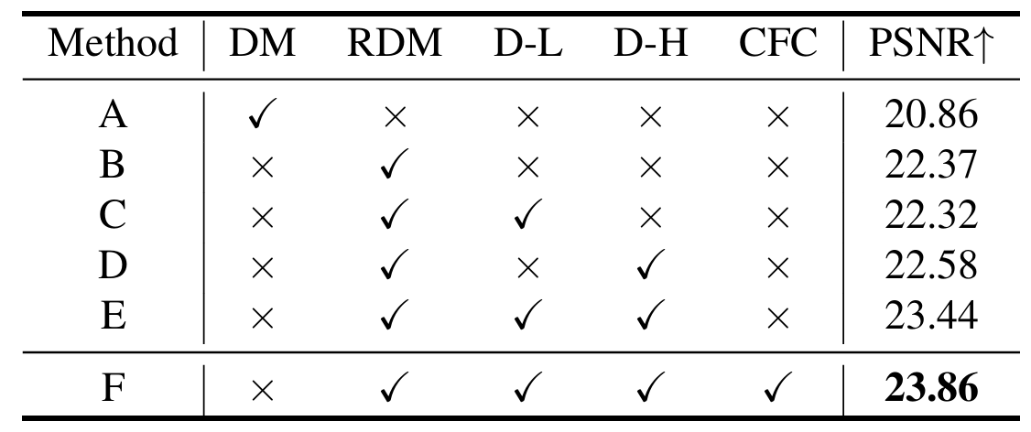
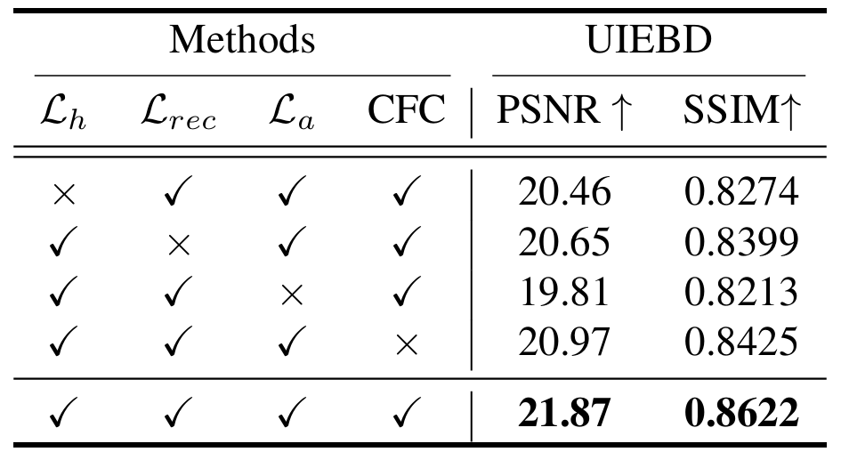
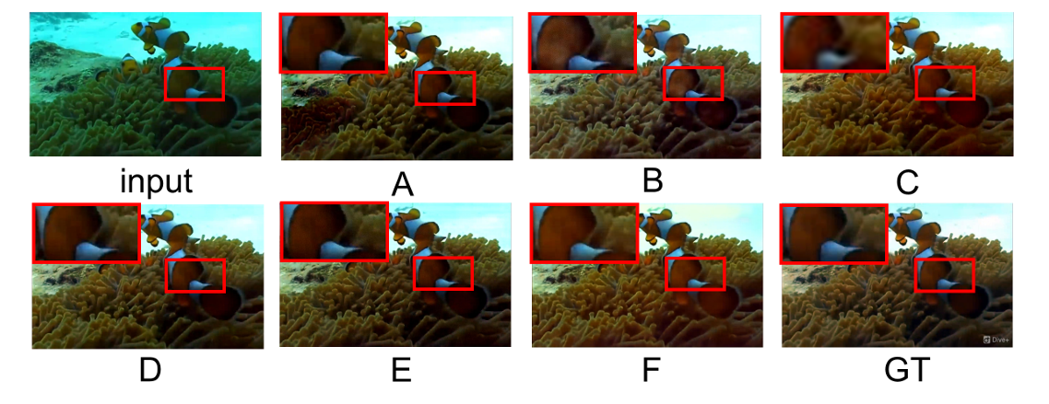
ATAI
Advanced Technique of Artificial Intelligence
ATAI
ChongqingUniversity _{AdvancedTechniqueof}
of Technology Artificial Intelligence
Chongqing University of
Technology
Chongqing University ^{ATAI}
_{of Technology} Advanced Techniqueof
Artificial Intelligence
Chongqing University of Technology
Chongqing University of Technology
Experiments

Slide 13
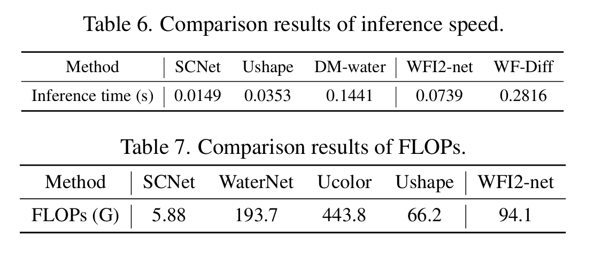
ATAI
Advanced Technique of Artificial Intelligence
ATAI
ChongqingUniversity _{AdvancedTechniqueof}
of Technology Artificial Intelligence
Chongqing University of
Technology
Chongqing University ^{ATAI}
_{of Technology} Advanced Techniqueof
Artificial Intelligence
Chongqing University of Technology
Chongqing University of Technology
Experiments

Slide 14
ATAI
Advanced Technique of Artificial Intelligence
ATAI
ChongqingUniversity _{AdvancedTechniqueof}
of Technology Artificial Intelligence
Chongqing University of
Technology
Chongqing University ^{ATAI}
_{of Technology} Advanced Techniqueof
Artificial Intelligence
Chongqing University of Technology
Chongqing University of Technology
Thanks!

